Slide 1



Installation of Ubuntu MATE in Raspberry PI
Chirag Sharma - 16010121186
Uditi Sinha - 16010121194
Aditya Ved - 16010121208

Slide 2
Introduction
Ubuntu MATE offers a user-friendly desktop environment that's easy to navigate, making it suitable for basic desktop computing tasks.
Ideal for makers and device hackers, it provides a robust platform for creating and experimenting with projects using ARMv7 and ARMv8 architecture.
It's a convenient choice for prototyping IoT devices in a desktop environment, allowing you to build and test applications as snaps, simplifying the development process.
Ubuntu MATE is designed to run efficiently on the Raspberry Pi, making the most of its hardware capabilities while minimizing resource usage.
Users can expect regular security updates and long-term support (LTS) for a stable and secure computing environment.

Slide 3
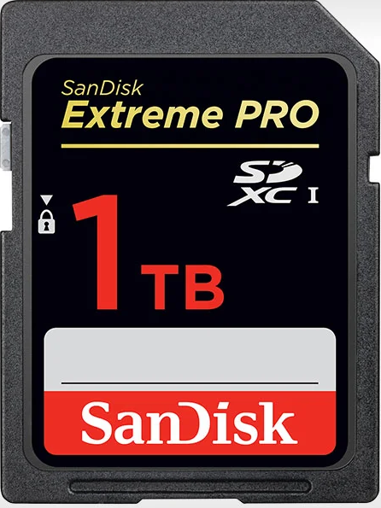
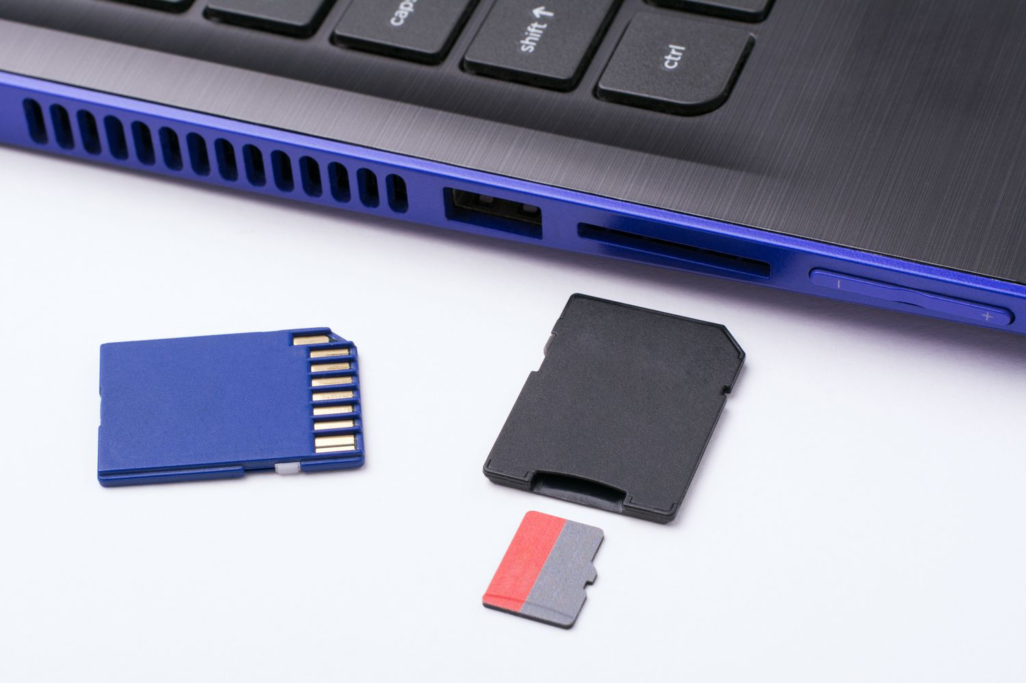
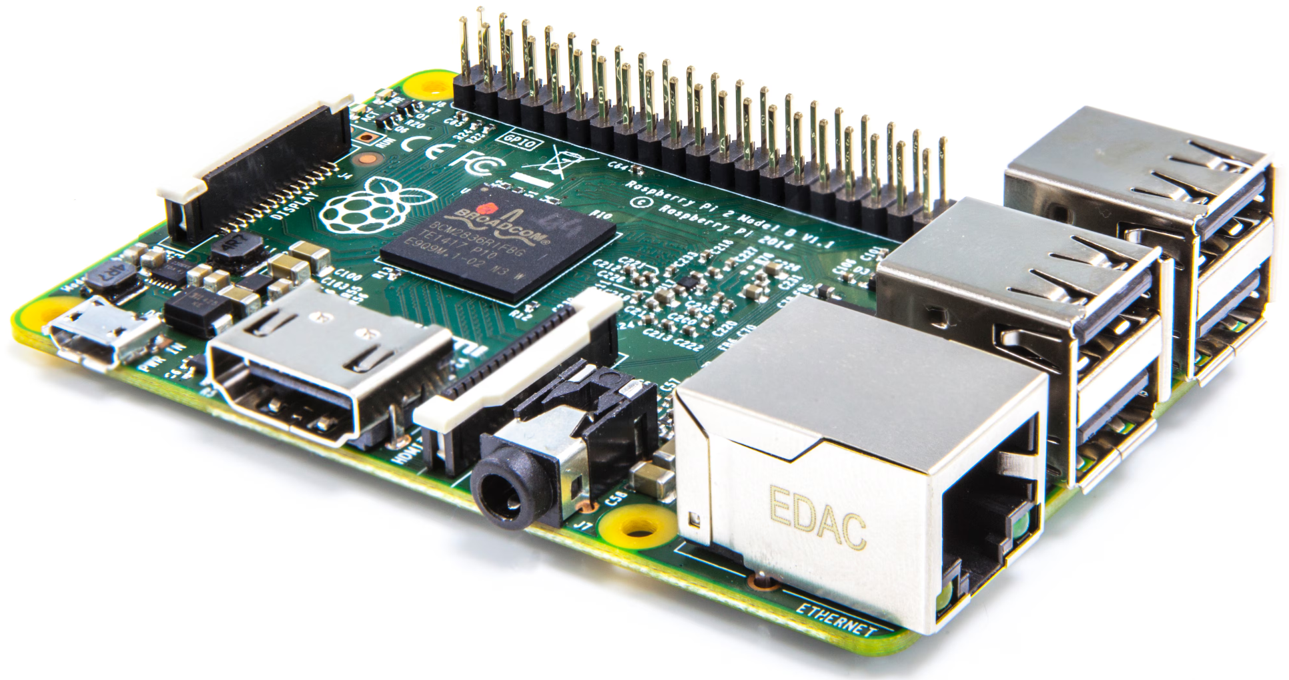
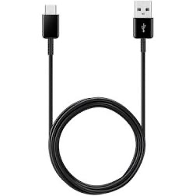
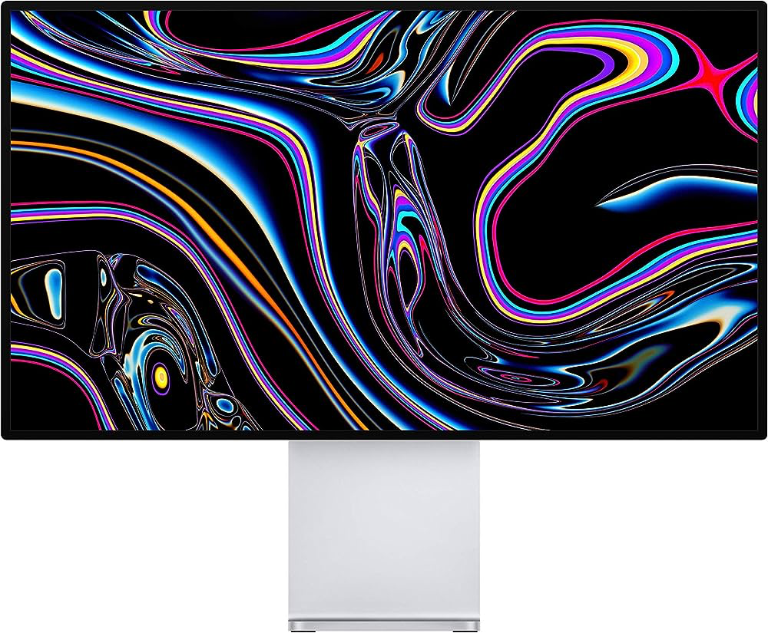
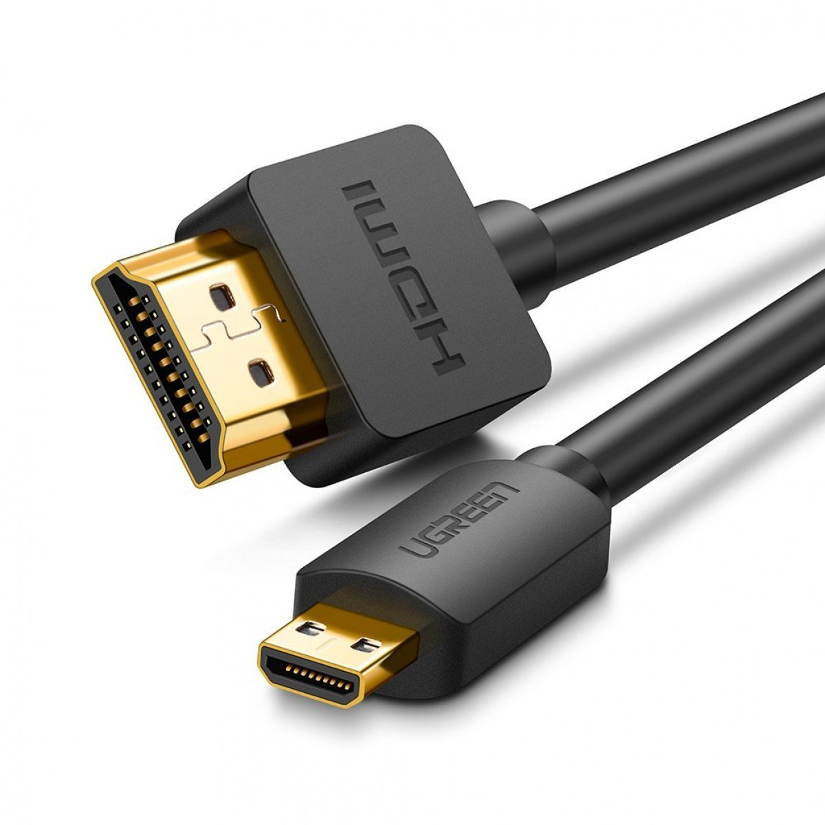
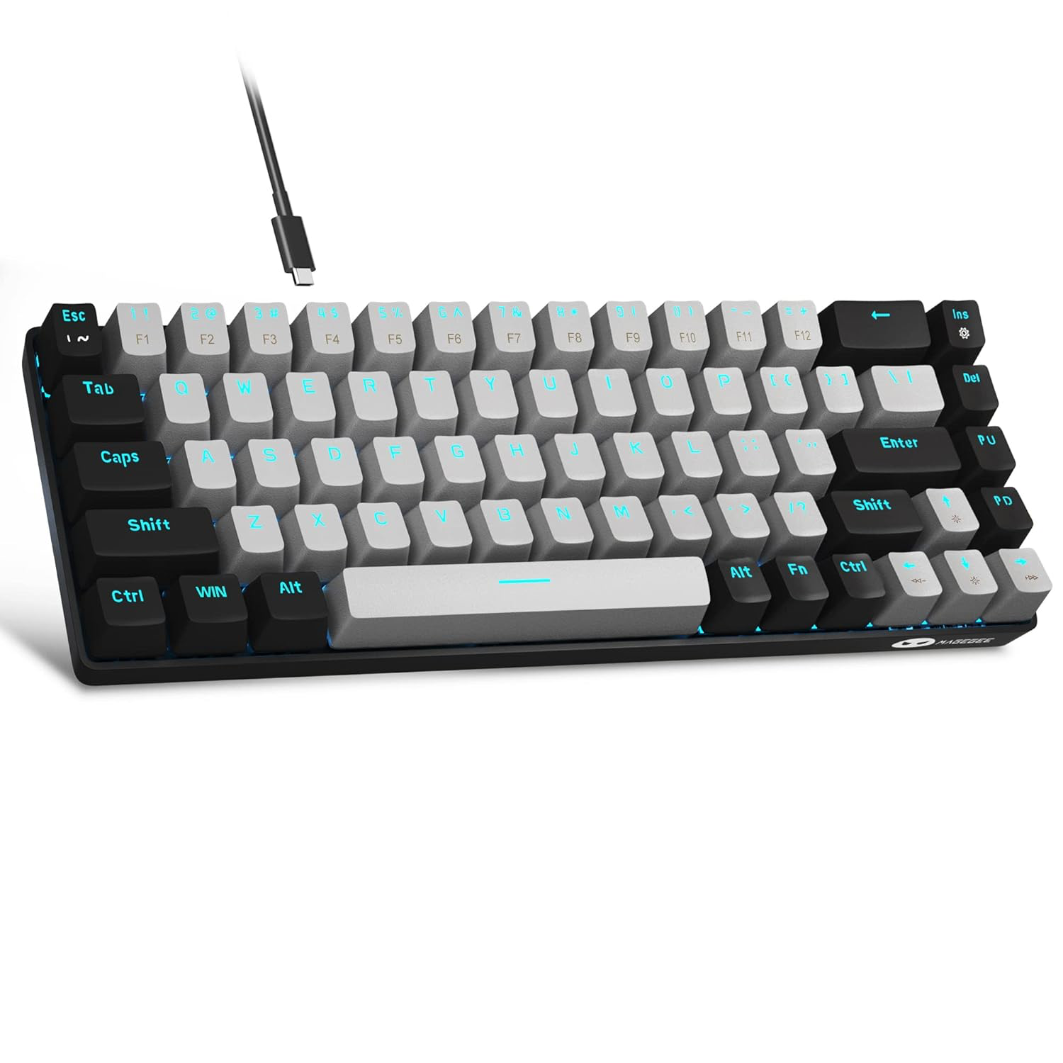
Requirements for Installing Ubuntu MATE on Raspberry PI
A microSD card (8GB minimum, 16GB recommended)
A computer with a microSD card drive
A Raspberry Pi 2 or newer
A micro USB-C power cable
A monitor with an HDMI interface
A micro HDMI cable
A USB keyboard

Slide 4
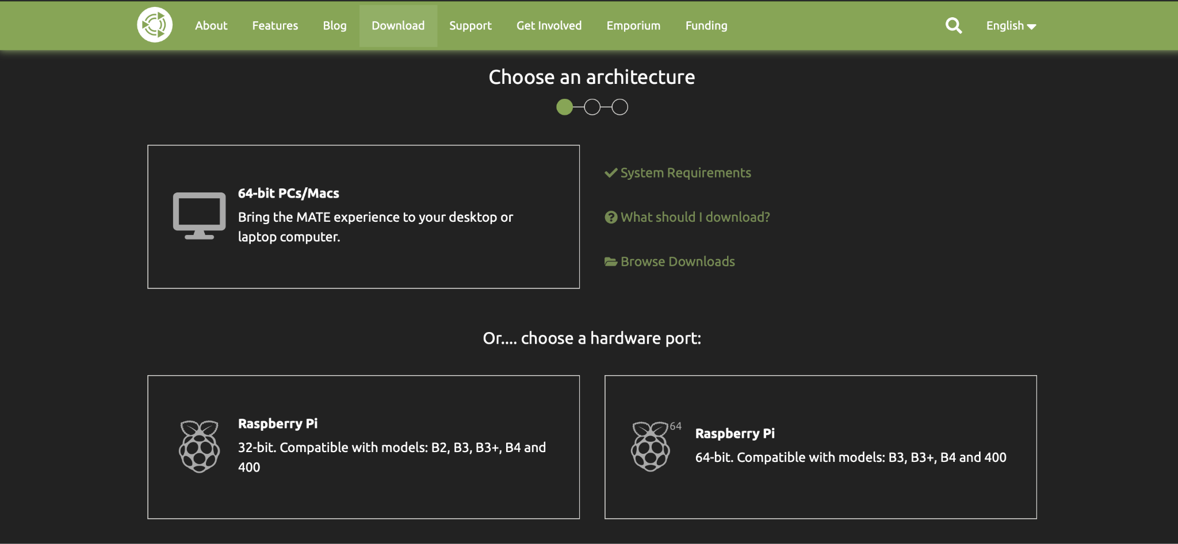
Steps for Installing Ubuntu MATE on Raspberry PI
Step 1: To download Ubuntu Mate for our Raspberry Pi, we will need to go to the official Ubuntu Mate website (Download either the 32-bit or 64-bit image depending on your needs)

Slide 5
Steps for Installing Ubuntu MATE on Raspberry PI
Step 2: Prepare the SD Card
First, insert the microSD card into your computer. You need to install the right Raspberry Pi Imager for your operating system. You can do this on Ubuntu by running:
sudo snap install rpi-imager

Slide 6
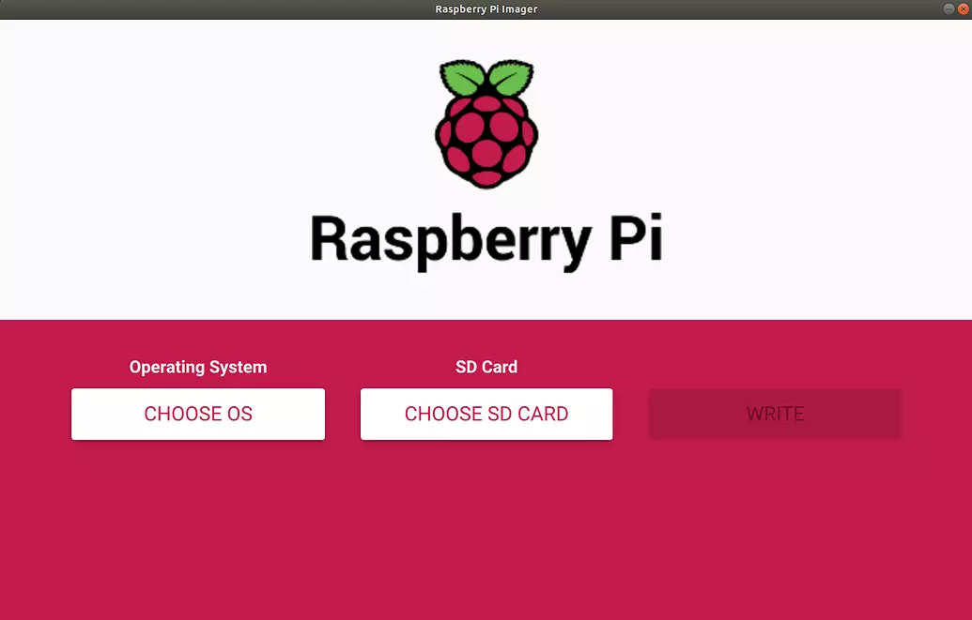
Steps for Installing Ubuntu MATE on Raspberry PI
Step 3: Once this is done, start the Imager and open the “CHOOSE OS” menu.

Slide 7
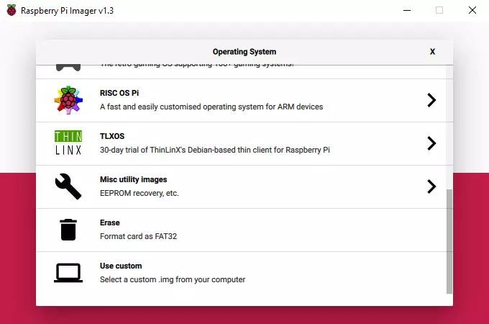
Steps for Installing Ubuntu MATE on Raspberry PI
Step 4: Scroll down the menu and click “Use custom”.

Slide 8
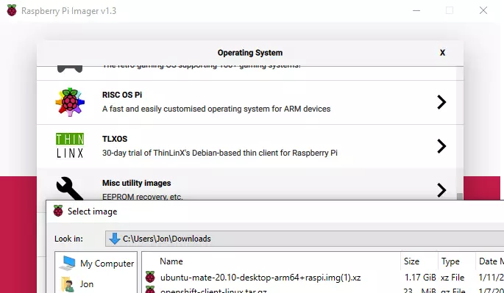
Steps for Installing Ubuntu MATE on Raspberry PI
Step 5: A dialog box will open asking you to choose the image you wish to burn. Click through and select your file.
Step 6: Once you have made your custom image selection open the “SD Card” menu.
Step 7: Select the microSD card you have inserted, and click “WRITE”. Then just sit back and wait.

Slide 9
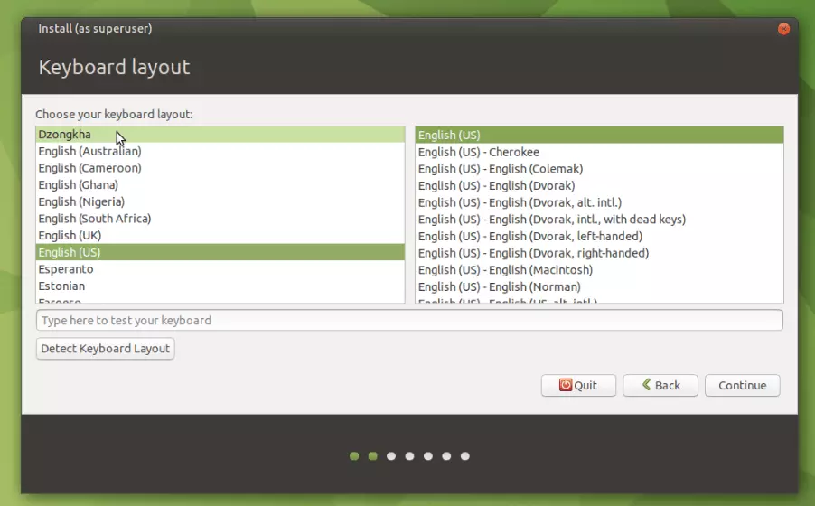
Steps for Installing Ubuntu MATE on Raspberry PI
Step 8: Boot your Desktop.
Ensure your HDMI screen and a USB keyboard are plugged in before powering the Pi.
You will be able to see the boot process on screen and, eventually, the first run wizard.
First set your language, then set your keyboard layout.

Slide 10
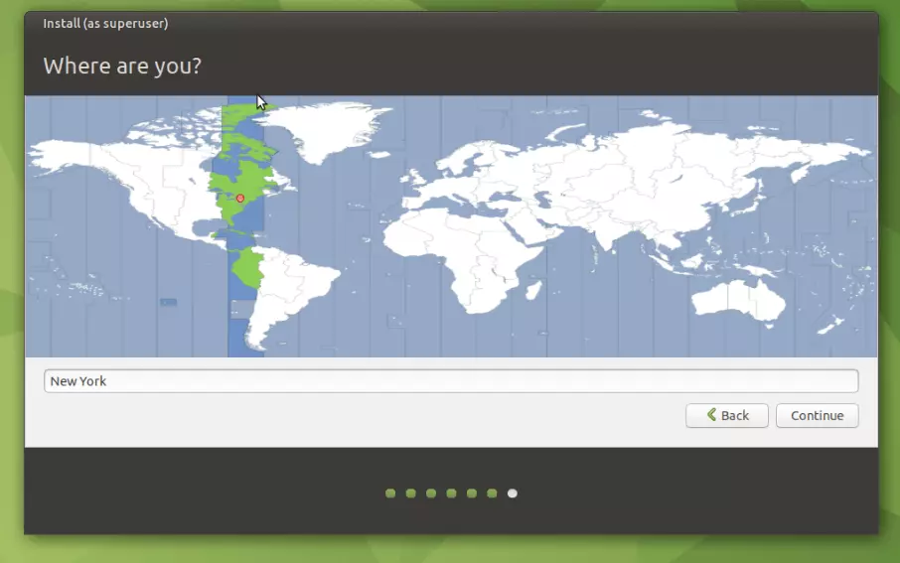
Steps for Installing Ubuntu MATE on Raspberry PI
Step 9: Now pick yourself a time zone.
Unlike conventional computers, the Raspberry Pi does not have a battery-powered hardware clock and must sync the date and time from the Internet.

Slide 11
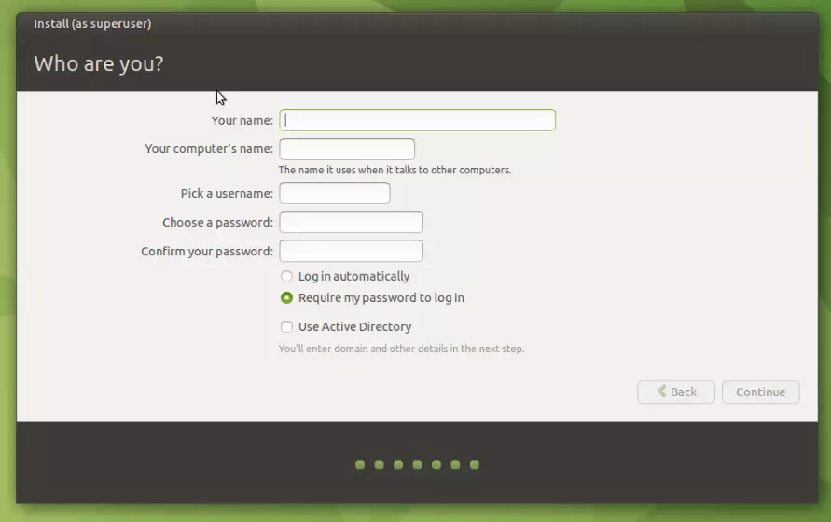
Steps for Installing Ubuntu MATE on Raspberry PI
Step 10: Choose a user-name and
password.
You will be prompted to choose a local Wi-Fi network.
Select your Wi-Fi network and enter the password in the network connection screen.
Now choose a user-name and password.

Slide 12
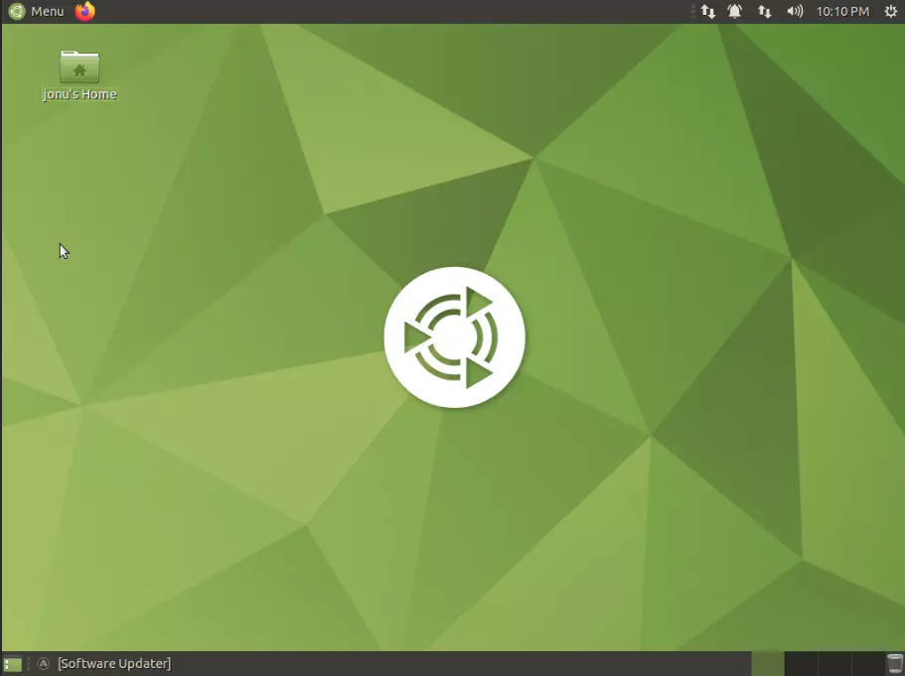
Steps for Installing Ubuntu MATE on Raspberry PI
Step 11: Welcome to your new
Ubuntu MATE Desktop.
After setting the keyboard layout, time zone and user credentials you’ll be taken to the login screen after a few minutes.
You are almost done.
Welcome to your new Ubuntu MATE Desktop.

Slide 13
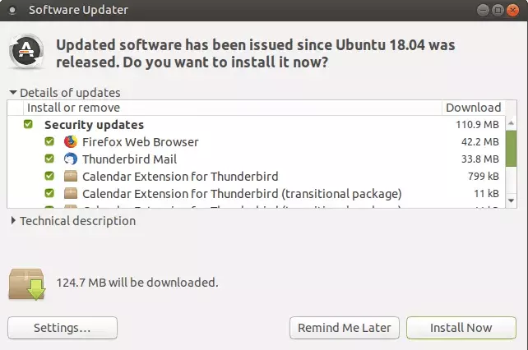
Steps for Installing Ubuntu MATE on Raspberry PI
Step 12: Update Ubuntu MATE.
Once logged in, the first thing you should do is to update Ubuntu MATE.
This can be done via the Software Updater application.
Alternately, you can update via the Terminal:
sudo apt update
sudo apt full-upgrade

Slide 14
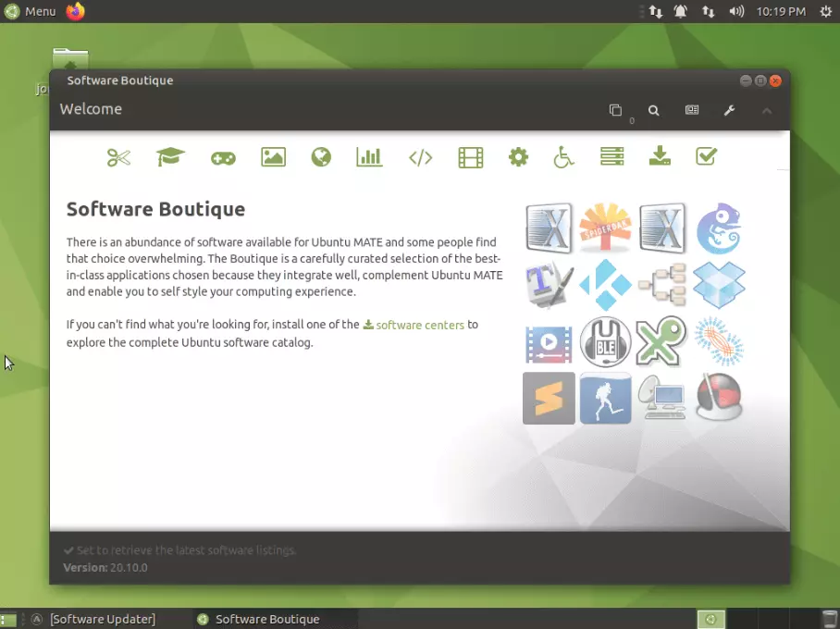
Steps for Installing Ubuntu MATE on Raspberry PI
Step 13: Enjoy your Ubuntu MATE.
At this point you can enjoy your MATE set up as is, or add software as needed through the Software Boutique.

Slide 15
Features of Ubuntu MATE
Ubuntu MATE uses the MATE desktop, which is a continuation of the classic GNOME 2 interface. It provides a traditional, easy-to-use, and customizable desktop experience.
It is compatible with Raspberry Pi devices, allowing users to enjoy a full-fledged desktop environment on this popular single-board computer.
Ubuntu MATE is designed to be resource-efficient, making it suitable for older hardware or systems with limited computing power.
Users can easily personalize their desktop with themes, icons, and layouts to suit their preferences.
Ubuntu MATE releases LTS versions, which means users receive long-term support and security updates for five years, ensuring a stable computing environment.

Slide 16
References
https://www.raspberrypi.com/
https://ubuntu-mate.org

Slide 17
THANK YOU!!

